Slide 1
university of Diyala collage of Engineering Dep. Of communication
Microwave Engineering Lecture 2: plane wave

Slide 2
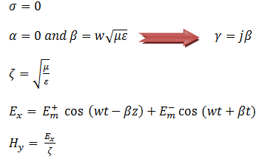
Electromagnetic Wave Motion 2.1 Propagation of uniform plane wave in a lossless dielectric media ( un damped uniform plane wave)
For lossless

Slide 3
2.2 propagation of plane wave in loss media

Slide 4
When a loss media is a good conductor

Slide 5
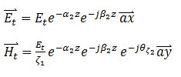
2.3 Normal incident of uniform plane wave on plane boundaries

Slide 6
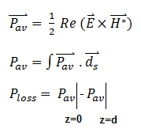
2.4 Reflection and transmission coefficient

